Slide 1
The Art of Allegory
English 9 Honors

Slide 2
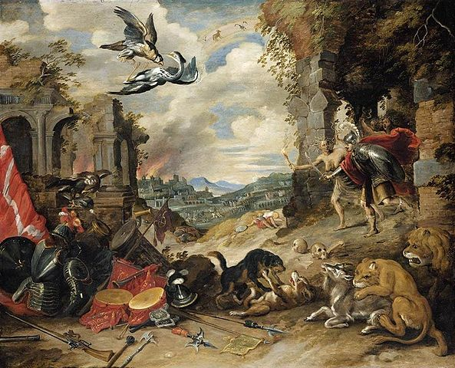
What is an allegory?
Let’s look at an artistic example.
Turn and talk to your neighbor: What details do you notice in this painting? List these details in your notes.

Slide 3
What is an allegory?
The term allegory comes from the Greek word allegoria which means “speaking otherwise”.
It refers to a complete narrative (story), poem, or piece of art that may be interpreted to have a double meaning.
One meaning is the literal, or on-the-surface. In a story, this is simply the plot of events, characters, and setting. What did you see in the painting?
The other meaning is hidden or figurative.
The hidden meaning of an allegory is connected to a moral, religious, political, or social message or theme the author is trying to convey to the reader.

Slide 4
What is an allegory?
Allegory of War
painted by Jan Brueghel the Younger in the 1640s during the Baroque period
What ideas about war could the author have been trying to convey?

Slide 5
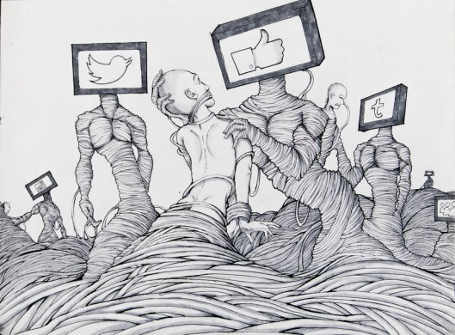
What is an allegory?
What do you see on the surface?
What ideas about life could the artist have been trying to convey?

Slide 6
Elements of an Allegory
An allegory is a form of extended metaphor.
A metaphor is a comparison between two things used in literature to reveal things about something an author is describing.
The room was a furnace.
Love is a battlefield.
All the world is a stage, and all men and women merely players.
A metaphor is like a simile, but a simile uses the words “like” or “as”.
Life is like a box of chocolates.
His smile was as sweet as candy.
Do you ever feel like a plastic bag drifting through the wind?
An extended metaphor simply refers to when the metaphor extends through the whole narrative or text.

Slide 7
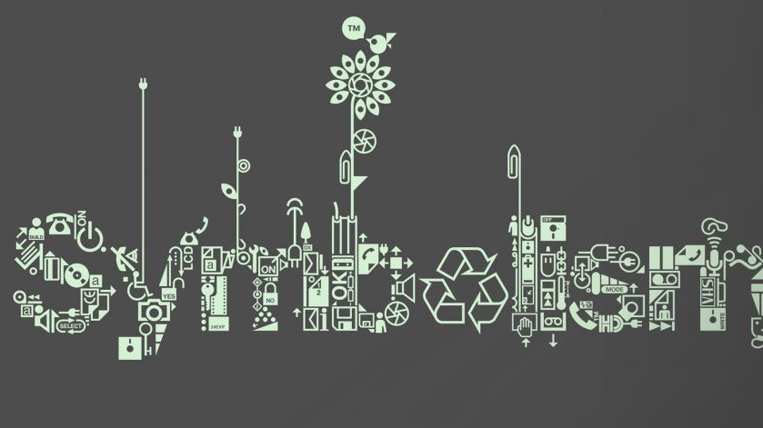
Elements of an Allegory
The author uses symbols to help develop the message or theme in an allegory.
A symbol is an object, image, character, action, event, or idea that is used to represent something else.

Slide 8
Elements of an Allegory
A symbol is an object, image, character, action, event, or idea that is used to represent something else. For example:
LOVE
Hearts, Cupid’s arrows, and even the color red can represent love.

Slide 9
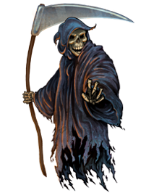
Elements of an Allegory
A symbol is an object, image, character, action, event, or idea that is used to represent something else. For example:
DEATH
The Grim Reaper and the color black could represent death.

Slide 10
Elements of an Allegory
A symbol is an object, image, character, action, event, or idea that is used to represent something else. For example:
PEACE
Doves represent peace or hope in stories.

Slide 11
Ancient Allegory
Philosopher Plato
Studied under Socrates, taught Aristotle
Philosophy is the art of “thinking about thinking”
Philosophers strive to think about ways to explain the world around us as a means of better understanding it
“The Cave”

Slide 12
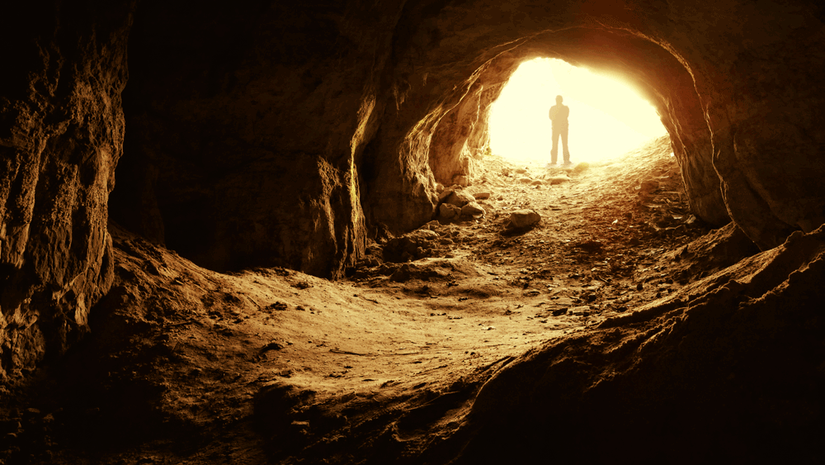
Plato’s Allegory of “The Cave” What do you know about caves?

Slide 13
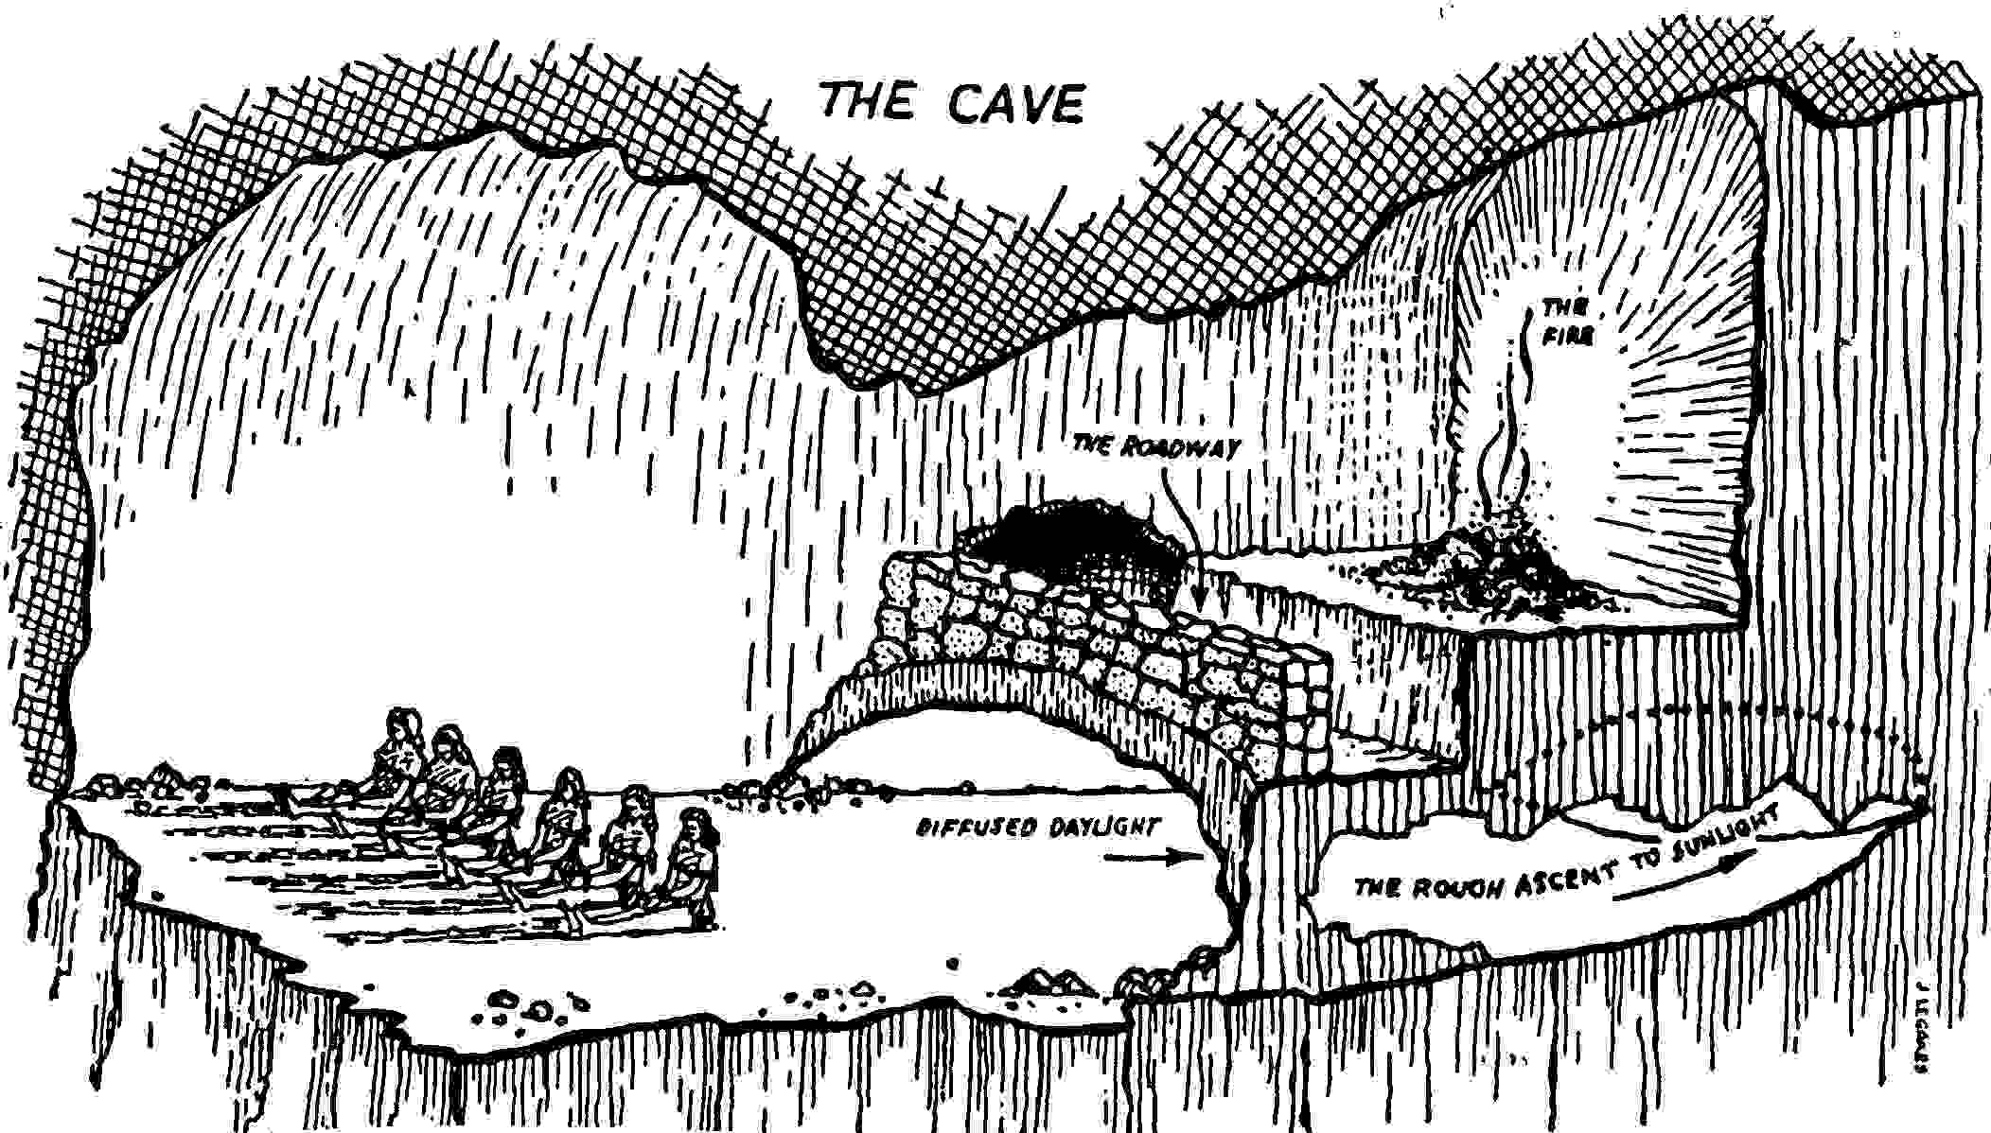
Plato’s Allegory of the Cave

Slide 14
Plato’s Allegory of the Cave
What’s the literal (on-the-surface) meaning? Fill out your notes by creating a brief summary of what happened in the story. You can just make a bulleted list.
What’s the figurative meaning? What idea or theme could Plato have been trying to make about life? Brainstorm your ideas in your notes and then we will share out.

Slide 15
Plato’s Allegory of “The Cave”

Slide 16
Plato’s Allegory of the Cave Extend Your Thinking!
What meaning does Plato’s allegory of “The Cave” in our world today?
What might some of the things in the story symbolize? Cave Prisoners Shackles

Slide 17
Allegory Research Assignment
Due: Tuesday, January 16th, Presented in small groups
Research the novel you read in December as an example of allegory.
Write a four paragraph expository report on your findings.
Paragraph 1: Summarize the literal meaning of the story
Paragraph 2: Discuss the allegorical meaning(s) or theme(s) of your story gleaned from your research
Paragraph 3: Discuss at least three symbols in the novel and explain how each develops or relates to the hidden meaning
Paragraph 4: Discuss the relevance of your novel as an allegory to today’s society (Your Thoughts)
Cite all of your research sources appropriately.

