Slide 1
The Foundations of Argument

Slide 2
Components of a Solid Argument
The Question- What do you want to research/discover?
The Claim- Answer to the question “What do I think?”
The Reasons- Justify the answer to the question “Why do I think this?”
The Evidence- Supports the reasons “How do I know this?”

Slide 3
FORMULA FOR A GREAT THESIS

Slide 4
FORMULA FOR A GREAT THESIS
The position you take on an issue is also called your CLAIM.
List your reasons in the same order you intend to cover them in your essay.

Slide 5
USING WHAT YOU’VE LEARNED ON HOW TO FORMULATE A GREAT THESIS, REVISE YOURS. WRITE YOUR NEW THESIS STATEMENT ON THE FIRST LINE OF A NEW SHEET OF PAPER.
CLAIM

Slide 6
A strong thesis is great…but you still need to
HEAT THINGS UP!!!!

Slide 7
Make your introduction HOT!!
H-OOK
O-RIENT
T-HESIS

Slide 8
Make your introduction HOT!!
H-OOK Engage your reader’s attention. Make them want to read what you have to say.

Slide 9
Make your introduction HOT!!
O-RIENT Give your reader enough background information to understand and care about the topic.

Slide 10
Make your introduction HOT!!
T-HESIS Save the best for last. Wrap up your introduction with a clear and confident argument.

Slide 11
Homework Assignment
Try writing 3-4 different hooks. Use a different type of hook each time.
Do some relevant research. Search for facts, quotes, statistics, stories, etc. that might work to engage your audience.
Remember your reasons. Don’t write a hook that branches away from your claim or reasoning.

Slide 12
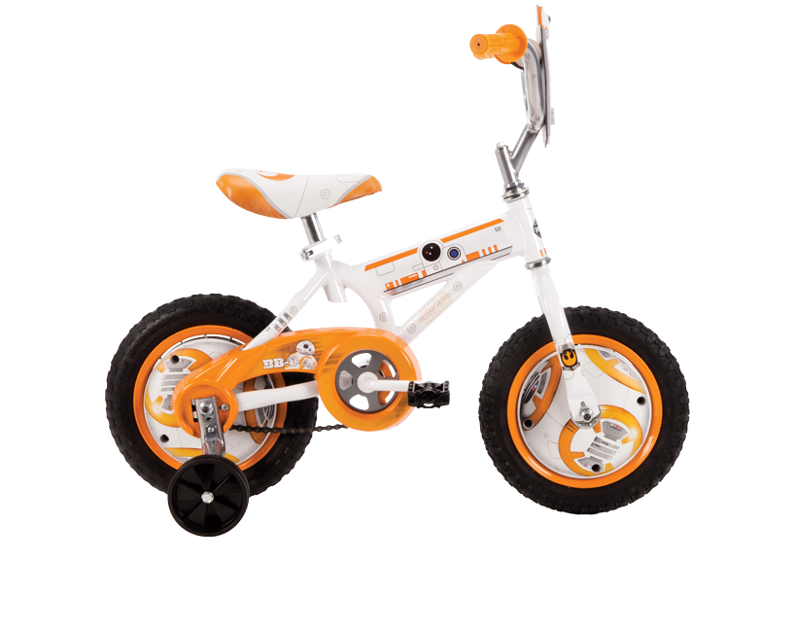
The Body of Your Argument
Is your orientation enough? Will your audience fully understand the topic enough to care about your argument? Or, do you need to build their understanding a bit more. As an option, include a paragraph after your introduction:

Slide 13
Your thesis has already laid out each of your supporting body paragraphs:
Support Paragraph #1
Support Paragraph #2

Slide 14
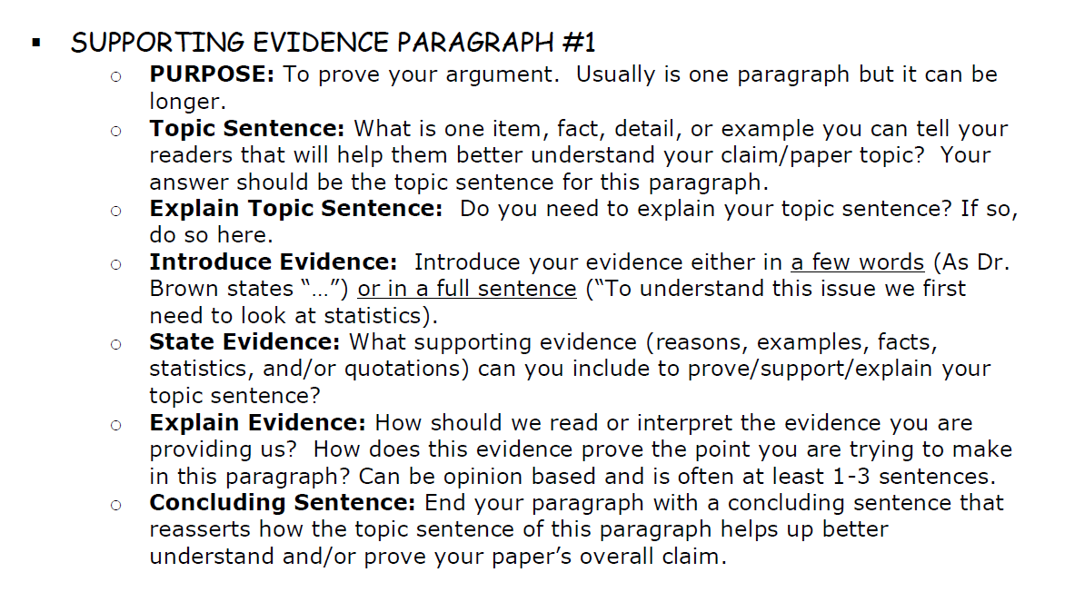
Repeat these steps for each piece of evidence.

Slide 15
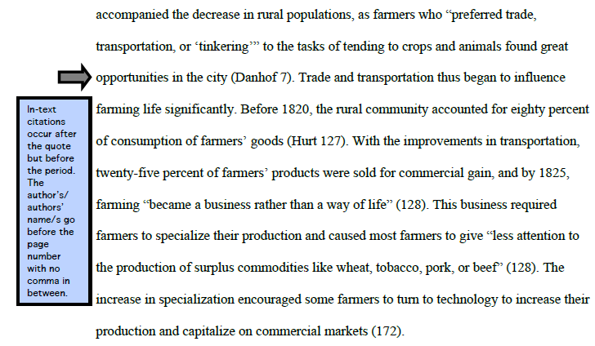
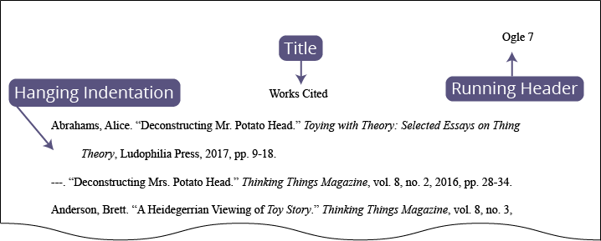
Add in-text citations for each piece of evidence. These reference which source on your works cited list you retrieved the information from.

Slide 16
A report published in The American Psychology Journal in 2016 stated, “…” In an article on the issue, Eleanor Geisel, renowned journalist for The Daily Times, reported that, “…” According to statistics collected in the 2010 national census, “…” As depicted in Table 2, …
The first time you reference one of your sources in a paper, be sure to identify the source it came from by introducing it in your sentence.

Slide 17
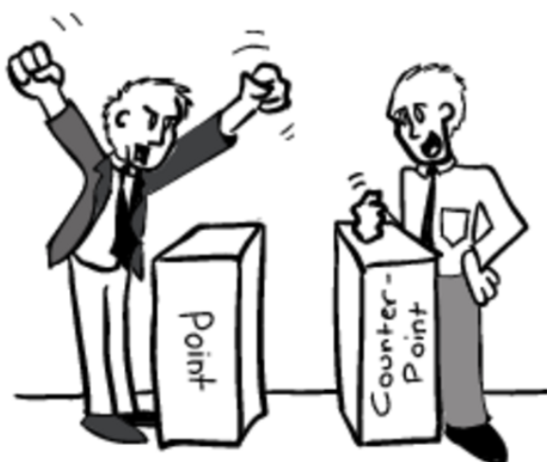
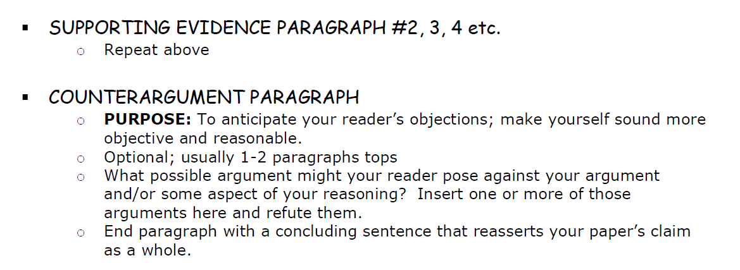
The Body of Your Argument

Slide 18
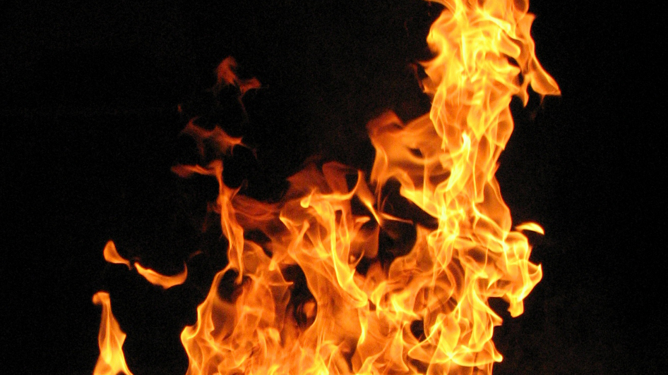
Now your reader should be really
You should probably cool things
down a bit before you leave them…

Slide 19
End with a COOL Conclusion!
C-ircle back to the intro
Is it effective/appropriate
to connect back to your hook?
RESTATE YOUR THESIS IN A NEW WAY!

Slide 20
End with a COOL Conclusion!
O-utline the points you made
Briefly relist and summarize the points you’ve just made in support of your claim and how they were organized.

Slide 21
End with a COOL Conclusion!
O-pen some doors & L-eave them wondering Give the reader something to think about! Why should they continue to care about your argument.
Quote a relevant source/person
Discuss the larger implications of the issue
Make real world connections
Connect to a different context (ex. then to now)
Call the reader to action

Slide 22
