Slide 1
Theme Development
Central Idea in Literature

Slide 2
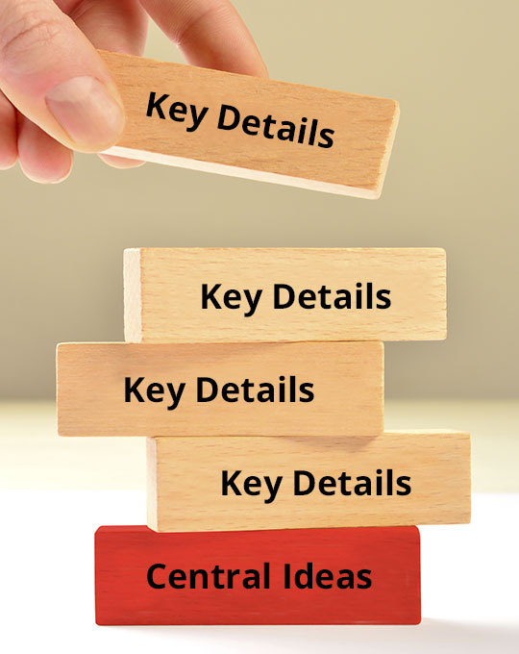
What is Central Idea?
The main idea of a piece of text.
The main point the author was trying to make.
All of the details an author includes in a text help to develop and support their central idea.

Slide 3
What is Theme?
Theme is the central idea of a piece of literary text or a work of art.
It is the meaning, life lesson, or moral of a story.

Slide 4
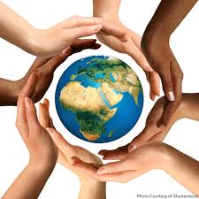
What is Theme?
The reason why an author wrote a story or the personal meaning we take away from it (the reason we read it)
A universal concept or abstract idea
Bigger than the story itself
Applied to anyone, anywhere, any time

Slide 5
What a Theme Is NOT
Communicated in one word
These are subjects or topics and are just a starting point for theme.
Theme is the universal point the author wants to make about the subject/topic.
LOVE
EQUALITY
WAR
FAMILY

Slide 6
How to find Theme?
Sometimes explicitly stated in the text
Sometimes inferred by the reader

Slide 7
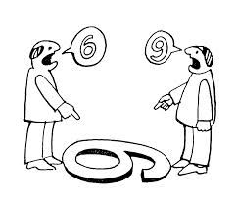
How to Find Theme?
Subjective- different readers might get different meanings
Up to interpretation- it depends on the reader’s personal beliefs and experiences

Slide 8
How does an Author Develop a Theme?

Slide 9
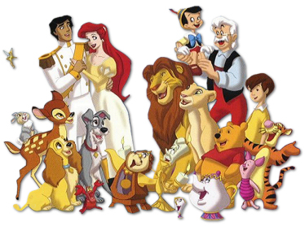
How does the author develop a theme?
Characters
How does the protagonist(s) change through the story?
What lessons do they learn?

Slide 10
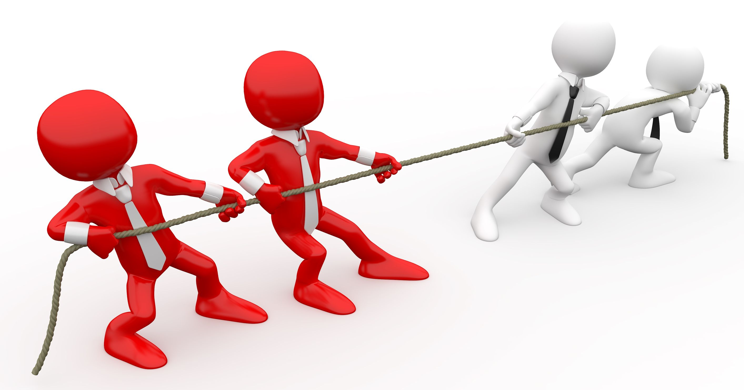
How does the author develop a theme?
Conflict
Who/What are the opposing forces?
Who/What wins?

Slide 11
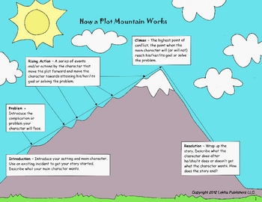
How does the author develop a theme?
Plot
What is the sequence of events?
What caused things to go this way?

Slide 12
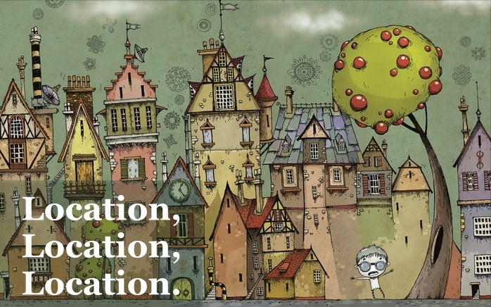
How does the author develop a theme?
Setting
What is the best time and/or place to teach this lesson?
What technology is available, what historical events were taking place, etc.?

Slide 13
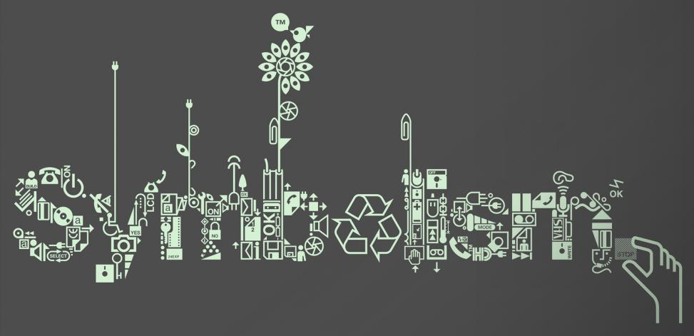
How does the author develop a theme?
Symbols
Characters, settings, events, images, objects, etc. can be used to represent things in the real world

Slide 14
What are symbols?
A symbol is an object, image, character, action, event, or idea that is used to represent something else. For example:
LOVE
Hearts, Cupid’s arrows, and even the color red can represent love.

Slide 15
What Are Symbols?
A symbol is an object, image, character, action, event, or idea that is used to represent something else. For example:
PEACE
Doves represent peace or hope in stories.

